Slide 1
MICROPROCESSORS PROJECT
Department Electrical & Electronic Engineering
College of Engineering
APRIL, 2025

Slide 2
GROUP 7
GROUP MEMBERS
Samuel Opoku 1873622
Amoakoh A.K Owusu 1871622
Charles Nana K. Duodu 7149421
Baidoo James 1872222
Alfred Amegavi Amuzu 1871722
Michael Mawuli Okrah 7150921

Slide 3
TABLE OF CONTENTS
Problem Statement
Methodology
Demonstration/Simulation
Key Outputs
Conclusion

Slide 4
PROBLEM STATEMENT
Many patients, especially the elderly, often forget to take their medication on time.
This can lead to severe health issues due to missed doses.
Our solution is a Smart Medicine Reminder that alerts the patient at specific times using an LCD and buzzer.
The system ensures that the patient acknowledges the alert by pressing a button before the alarm stops.

Slide 5
METHODOLOGY: CODE AND SCHEMATICS OVERVIEW
Code implementation:
Uses Adafruit_LiquidCrystal.h for LCD display.
Simulated time using delay() since Tinkercad lacks RTC.
Buzzer remains ON until button press is detected.

Slide 6
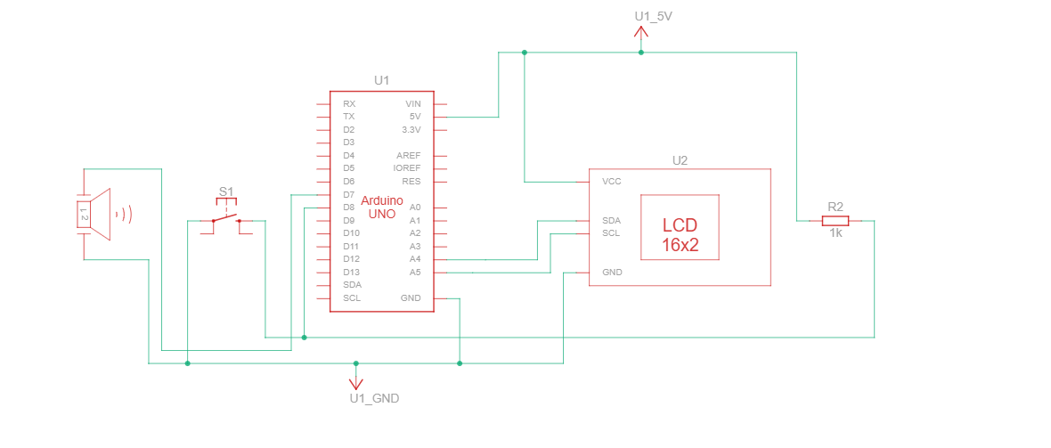
METHODOLOGY: CODE AND SCHEMATICS OVERVIEW
Schematic:
Tracks time in the loop function.
Displays the time and reminders on the LCD.
Triggers the buzzer at predefined medication times.
Stops the buzzer when the reset button is pressed

Slide 7
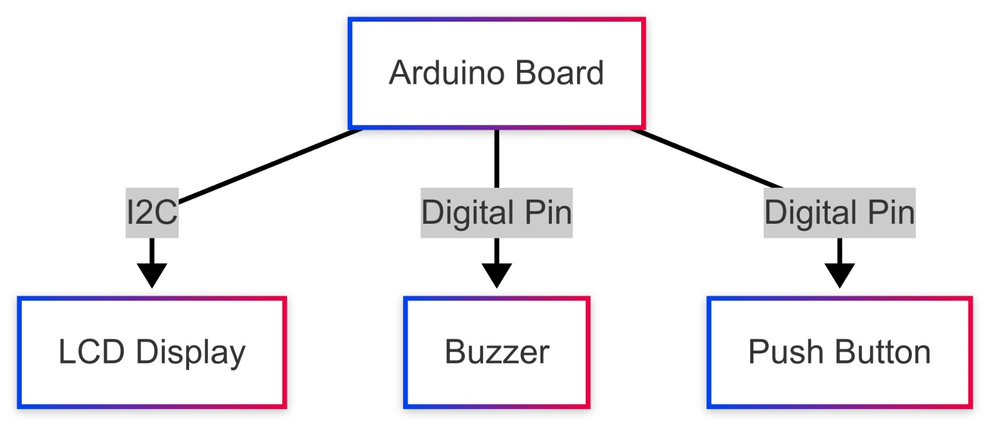
METHODOLOGY: CODE AND SCHEMATICS OVERVIEW
Components: Arduino, LCD, Buzzer, Push Button
Block Diagram showing how components are connected:

Slide 8
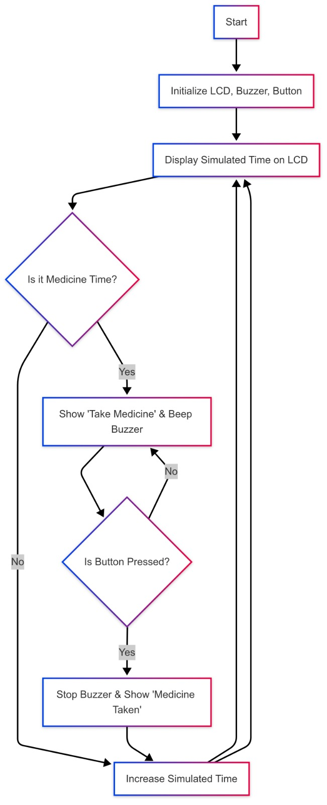
DEMONSTRATION/SIMULATION
Functionality showcase using a flowchart:
The system initializes and displays the simulated time on the LCD.
At medicine time, the LCD shows "Take Medicine Now!" and the buzzer starts beeping continuously.
The buzzer stops only when the button is pressed, confirming that the patient has been alerted.
The system then updates the time and waits for the next medicine alert.

Slide 9
KEY OUTPUTS
Before Medicine Time: LCD shows the current simulated time.
During Medicine Time: LCD prompts "Take Medicine Now!" and buzzer sounds.
After Button Press: LCD updates to "Medicine Taken" and stops the buzzer

Slide 10
CONCLUSION
Findings:
The system successfully reminds patients to take medicine using audio and visual alerts.
Ensures patient acknowledgment before stopping the alert.
Challenges:
Tinkercad does not support RTC, requiring a workaround with delay().
Button debouncing issues in early iterations, later resolved.
Possible Improvements:
Integrate an RTC module for real-time tracking.
Add a mobile notification system for remote reminders.
Expand functionality to support multiple medicines & dosage schedules.

Slide 11
Thank you !!!

